Slide 1

Implementation of BERT-Based QA System for Anime Context
2119167
Machine Learning

Slide 2
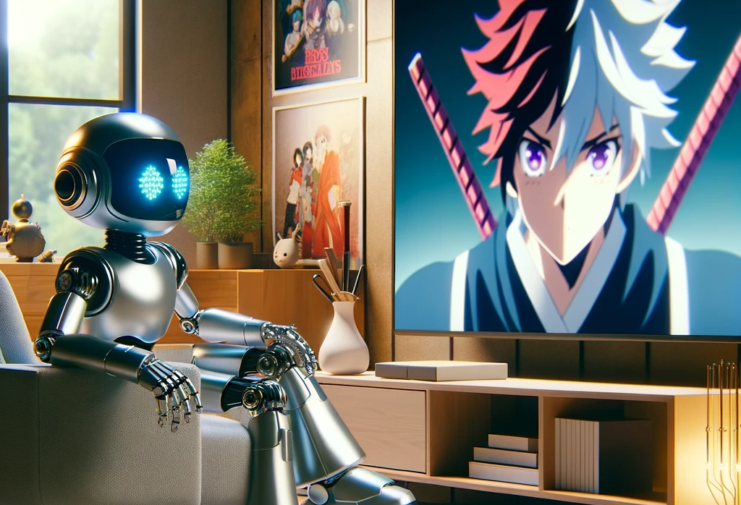



Purpose: To develop a question answering system that leverages BERT to enhance user interaction with anime content
Anime combines visual art and storytelling, captivating a global audience and presenting unique challenges for natural language processing.
Improves accessibility and interaction with related content.
Provide a platform for both new and seasoned fans to learn about anime narratives and characters

Slide 3

How does Bert- Based system works?
The system utilizes the BERT (Bidirectional Encoder Representations from Transformers) model, which processes natural language input to understand and generate responses. It does this by converting text into numerical data that the model can understand, analysing this data to capture context and relationships within the text, and then predicting the most relevant answers based on this analysis.

Slide 4
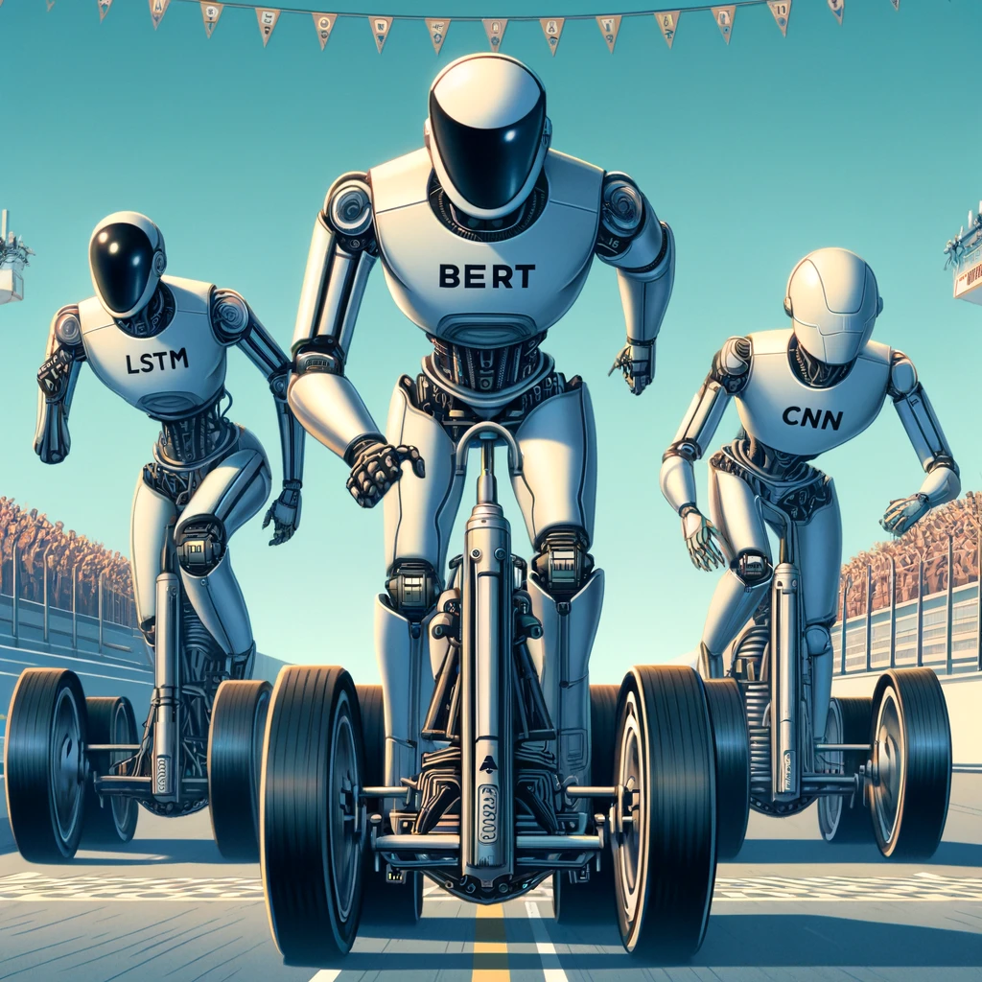
Why was BERT chosen over other models?
BERT was chosen due to its advanced capabilities in understanding context from text, which is crucial for accurately answering questions about detailed topics such as anime. Its pre-training on a vast corpus allows it to have a deep understanding of language, which is further fine-tuned to specific anime content to enhance accuracy and relevance in responses.

Slide 5
What kind of data does the system use?
The system is trained on a dataset comprising anime transcripts, fan discussions, and related content from online forums. This allows the system to cover a wide range of anime genres and styles, ensuring that it can respond accurately to varied user queries. It also contains written science explanations based on anime and cartoons.

Slide 6
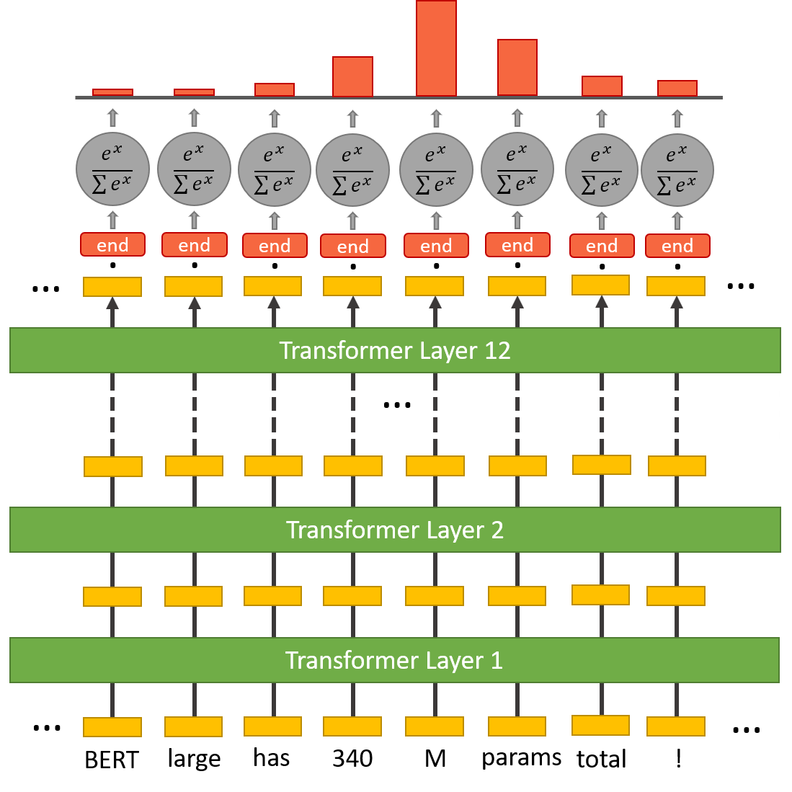

Data Handling Model Training & Model Evaluation

Slide 7
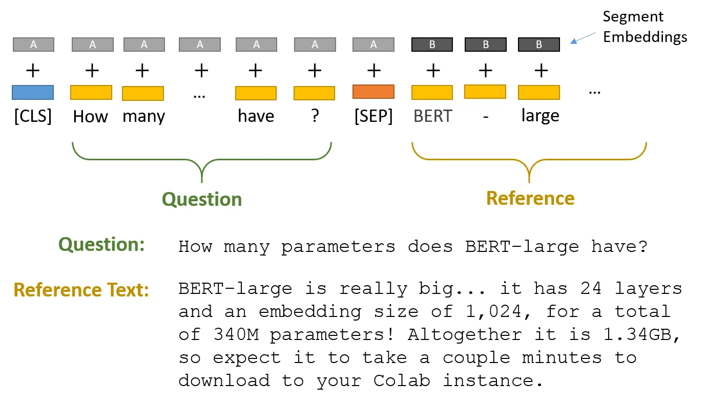
Bert system in Q&A

Slide 8
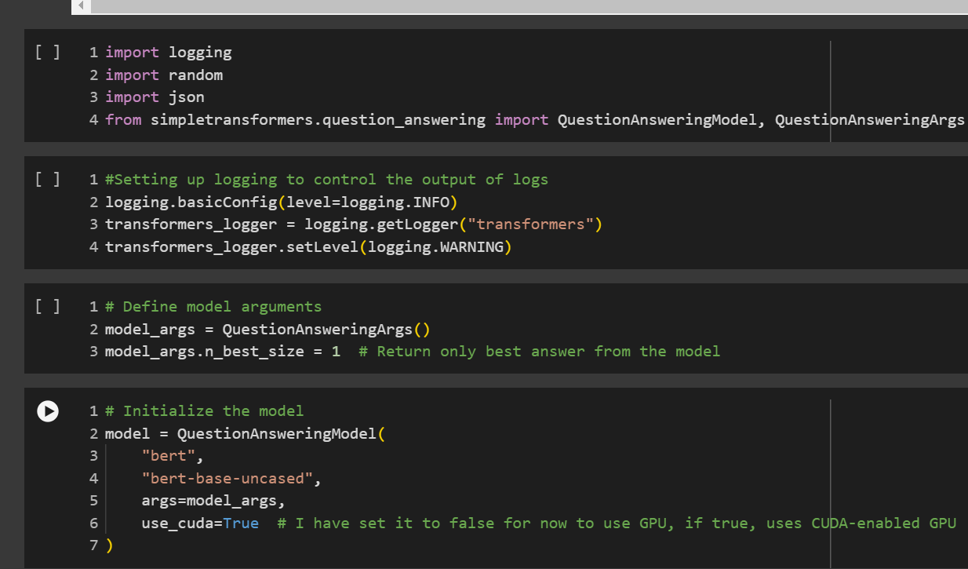
The simpletransformers question_answering module provides a straightforward interface to implement and train the BERT model,
logging helps in monitoring the model’s training process,
random is used to shuffle data to ensure the model's robustness by preventing order bias during training."

Slide 9
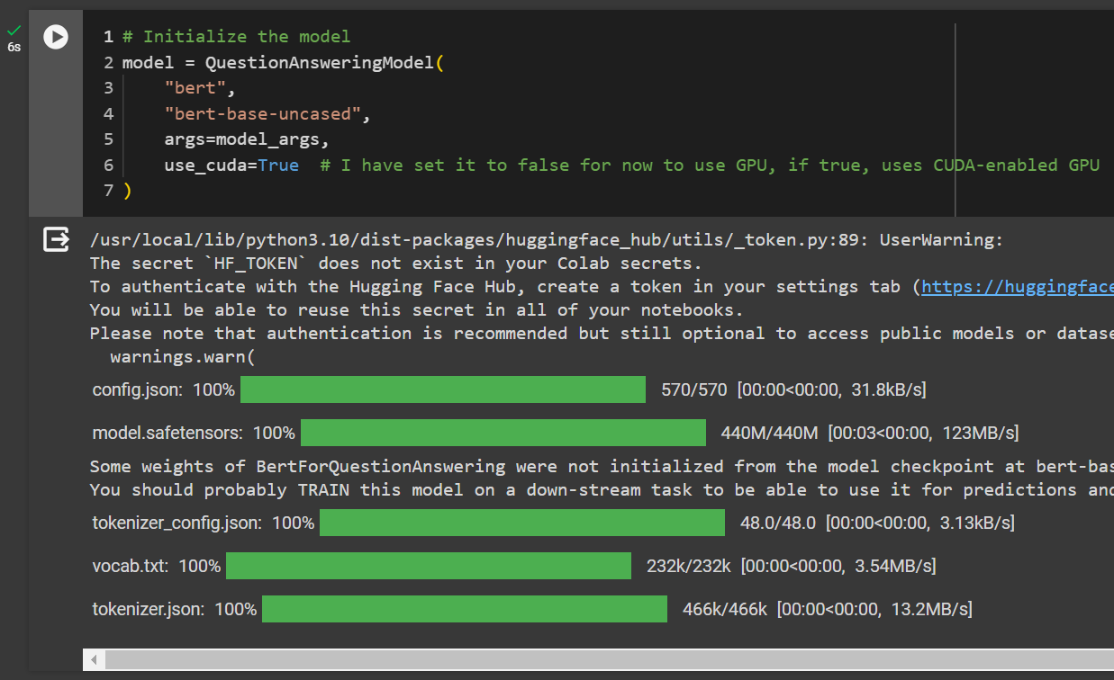
Model Initialization: The script begins by setting up a QuestionAnsweringModel from the simpletransformers library. This model uses the 'bert-base-uncased' version of BERT, which is particularly effective for understanding and processing text in lowercase without considering case sensitivity.
GPU Utilization: The parameter use_cuda=True is commented as being set to False temporarily. This parameter enables the model to utilize CUDA, a parallel computing platform and API model created by Nvidia, allowing for faster computation on Nvidia GPUs. This is essential for handling the computationally intensive tasks of training and inference with BERT.

Slide 10
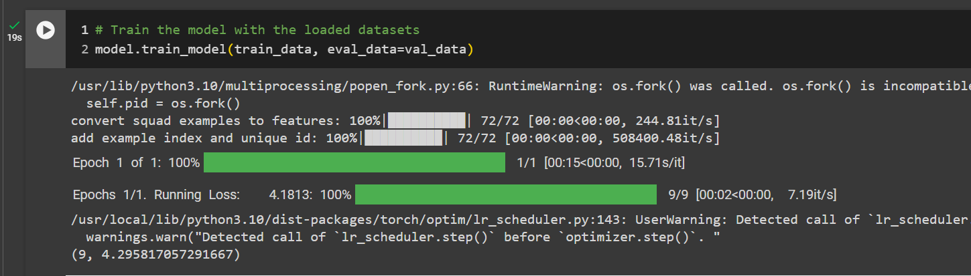
This line of code initiates the training of the question-answering model using the preprocessed and formatted data. The command specifies two key datasets:
train_data: This dataset comprises a substantial portion of the data, typically 80%, and is used to train the model. Training involves adjusting the model's internal parameters to minimize error and improve its ability to predict correct answers based on the input queries and context provided.
eval_data: Also known as validation data, this smaller dataset (often around 10% of the total data) is used to periodically evaluate the model's performance during training. This evaluation helps in monitoring the model’s accuracy and generalization ability on data it has not been trained on, which is crucial for tuning and preventing overfitting.

Slide 11
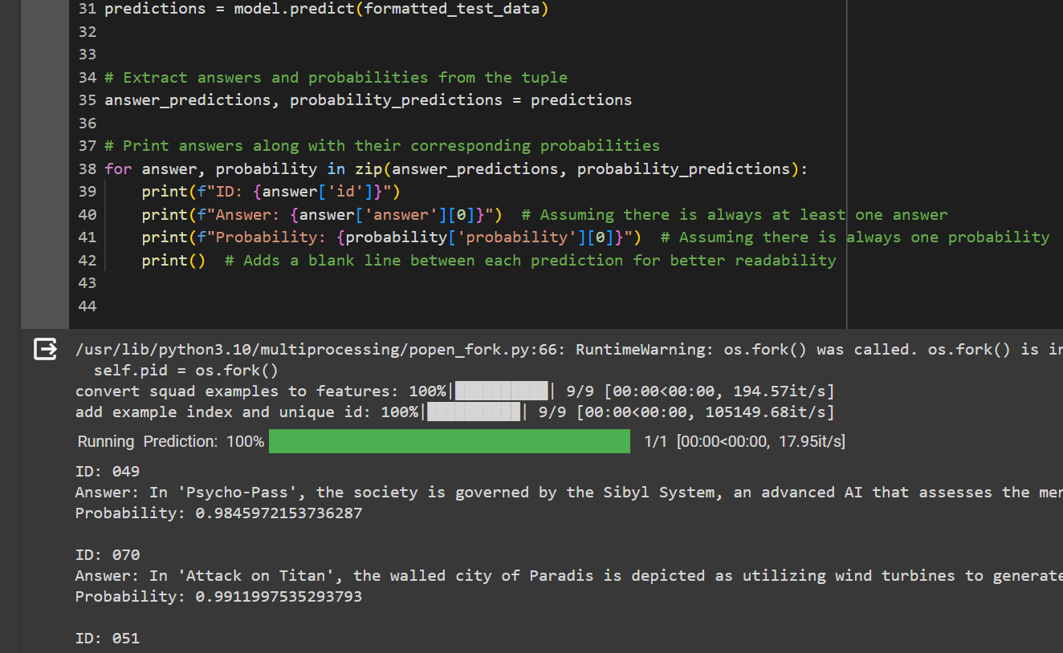
The script is running a function called model.predict() on formatted_test_data. This function is likely generating predictions based on the input data provided, which consists of various questions related to anime content.
The answers are examples of how the model has successfully interpreted the input data to generate relevant and highly confident responses.

Slide 12


Summary
So, this is the anime-based QA system, this can be made more promising by implementing more anime datasets and adding features like video data and multilingual support. Questions?

Slide 13

Thank You
2119167
SWE6204
Machine Learning
School of Creative Technologies

